Slide 1
Static Techniques
Software Testing
ISTQB / ISEB Foundation Exam Practice
1 Principles
2 Lifecycle
3 Static testing
4 Test techniques
5 Management
6 Tools
Chapter 3

Slide 2
CONTENTS
Static Techniques & Test Process
Review Process
Static Analysis

Slide 3
CONTENTS
Static Techniques & Test Process
Review Process
Static Analysis ( dùng tool để rà soát xem code có tuân theo chuẩn coding invention như sonaqueb hoặc eslint )

Slide 4
Static Testing
Reviews
Static Testing
Software Testing
Static Analysis
Dynamic Testing

Slide 5
Static Testing
Static analysis. The process of evaluating a component or system without executing it, based on its form, structure, content or documentation – "tool-driven evaluation“.
most often used to evaluate code against various criteria; e.g., adherence to coding standards, thresholds for complexity, etc.
Static testing. Testing a work product without code being executed.
broader than automated evaluations; reviews can be applied
Dynamic testing. Testing that involves the execution of the software of a component or system.

Slide 6
Work Products Examined by Static Testing
Any type of specification (biz reqs., functional reqs, sec. reqs.)
Epics, user stories, acceptance criteria
Code
Testware (i.e., any type of work product to do with testing)
User guides, help text, wizards
Web pages
Contracts, project plans, schedules, budgets
Models (e.g., activity diagrams, etc.)

Slide 7
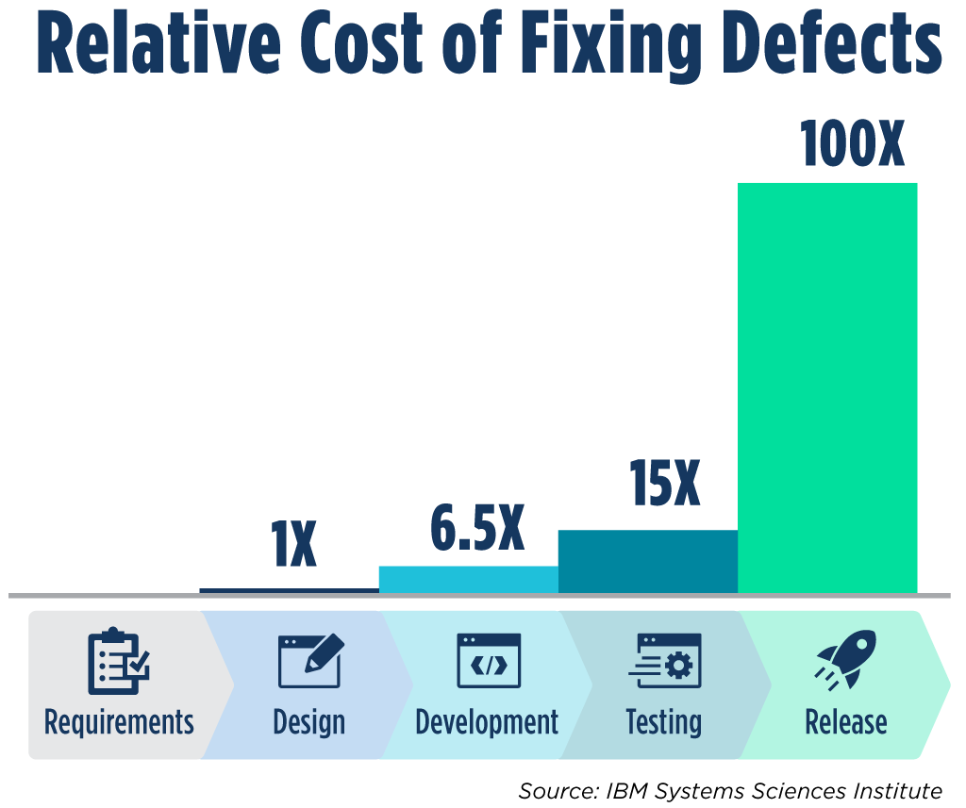
Benefits of Static Testing
Two major advantages:
Early feedback on quality issues
Relatively low rework costs

Slide 8
Benefits of Static Testing
Additional benefits:
More efficient detection & correction of defects
Identification of defects which are hard to find by dynamic testing
Prevention of defects in future design & code
Increased development productivity
Reduced development & testing code & time → reduced total cost of quality over the software’s lifetime
Improved communication w/i the team
Notes:
8 benefit

Slide 9
Reviews are cost-effective
10 times reduction in faults reaching test, testing cost reduced by 50% to 80%
Handbook of Walkthroughs, Inspections & Technical Reviews - Freedman & Weinberg
reduce faults by a factor of 10
Structured Walkthroughs – Yourdon
25% reduction in schedules, remove 80% - 95% of faults at each stage, 28 times reduction in maintenance cost, many others
Software Inspection - Gilb & Graham

Slide 10
Costs of reviews
Rough guide: 5% - 15% of development effort
half day a week is 10%
Effort required for reviews
planning (by leader / moderator)
preparation / self-study checking
meeting
fixing / editing / follow-up
recording & analysis of statistics / metrics
process improvement (should!)

Slide 11
Static vs Dynamic Testing
Similar objectives: to assess the quality of work products & identify defects as early as possible.
Dynamic testing can be started early, but its execution can only be applied to software code.
Static testing finds defects rather than failures (only dynamic testing can).
Static testing finds defect directly. Dynamic testing has to investigate the failure to find a defect.

Slide 12
Types of Defects
Requirement defects (e.g., inconsistencies, ambiguities, contradictions)
Design defects (e.g., inefficient algorithms, DB structure, high coupling, low cohesion)
Coding defects (e.g., unreachable code, duplicate code)
Deviations from standards (lack of adherence to coding standard)
Incorrect interface specifications
Security vulnerabilities (e.g., buffer overflow)
Traceability problems (gaps / inaccuracies / lack of coverage)
Maintainability defects (e.g., poor reusability, code smells)
Notes:
8

Slide 13
Other Objectives of Static Testing
Educational
Mutual understandings
Decision-making facilitation
Agreed commitment

Slide 14
Question
Which TWO of the following statements about static testing are MOST true?
A cheap way to detect and remove defects
It makes dynamic testing less challenging
Early validation of user requirements
It makes it possible to find run-time problems early in the lifecycle
When testing safety-critical system, static testing has less value because dynamic testing finds the defects better

Slide 15
Question
Which of the following is a correct definition of a review?
The review is an automated activity in which work products like requirements, code, and design are reviewed in order to find defects in them.
The review is mostly a manual activity in which work products like requirements, code, and design are reviewed in order to find defects in them.
The review is an automated activity in which the code is reviewed in order to find warnings and errors in it.

Slide 16
Question
Which of the following is correct?
Reviews rely on the manual examination of work products while static analysis is tool-driven
Static analysis relies on the manual examination of work products while reviews are tool-driven
Both reviews and static analysis are tool-driven

Slide 17
Question
When we find a defect in requirements or design, this will cost (............) finding the same defect in production.
more than
less than
the same as

Slide 18
Question
Which of the following techniques is a form of static testing?
Error guessing
Automated regression testing
Providing inputs & examining the resulting outputs
Code review

Slide 19
CONTENTS
Static Techniques & Test Process
Review Process
Static Analysis

Slide 20
Review Process
Review Process
Planning
Initiate review
Roles & Responsibilities
Author
Management
Review Types
Peer review
Walkthrough
Review Techniques
Ad hoc
Checklist-based
Individual review
Issue comms & analysis
Fixing & reporting
Facilitator
Review leader
Reviewer
Scribe
Technical review
Inspection
Scenario-based & Dry runs
Role-based
Perspective-based
Notes:
Ad hoc = when necessary

Slide 21
Reviews
Review – A type of static testing during which a work product or process is evaluated by one/more individuals to detect issues & to provide improvements.
Formality level depends on factors such as maturity of dev. process, legal/regulatory reqs., need for audit trail.
Informal review – A type of review w/o(without) a formal (documented) procedure.
most common type of review
Formal review – A form of review that follows a defined process w/ a ( with a) formally documented output.

Slide 22
Review Process

Slide 23
Work Product Review Process
Planning
Initiate review
Individual review
Issue communication & Analysis
Fixing & Reporting

Slide 24

REVIEW PROCESS: Planning
Defining the scope of the review
Estimating effort & timeframe for the review
Identifying review characteristics (review type, roles, checklists)
Selecting reviewers & assigning roles
Defining entry & exit criteria (for more formal review types)
Checking that entry criteria are met before the review commences

Slide 25

REVIEW PROCESS: Initiate Review
Distributing the work products & relevant material
Explaining scope, objectives, process, roles & work products under review to the participants
Answering any questions
Goal: get everyone on the same page

Slide 26

REVIEW PROCESS: Individual Review
Reviewing all or part of the work document(s)
Noting potential defects, recommendations & Qs
Use of checklists
Checking rate (i.e., #pages reviewed/hr.)
depends on type of work products, its complexity, # related work products, reviewer’s experiences
5 – 10 pages/hr. (less formal review)
1 page/hr. (for inspection)
Notes:
the "individual" typically refers to an expert or reviewer who is not the author of the product being reviewed.

Slide 27

REVIEW PROCESS: Issue Comm. & Analysis
Logging in a review meeting (severity levels: critical, major, minor)
No real discussion – focus on is logging as many defects as possible
Discussion
More formal review: logging & discussion parts are separated
Less formal review: logging mixed with discussion
Moderator takes care of people issues & how discussed items are handled
Decision marking: Evaluating the review findings against the exit criteria to make a review decision

Slide 28
REVIEW PROCESS: Fixing & Reporting
Creating defect reports
Fixing defects (typically by author)
Communicating defects to the appropriate person/team
Recording updated status of defects
Gathering metrics (for more formal review types; e.g., defects fixed, deferred, etc.)
Checking that exit criteria are met
Accepting work product when exit criteria is reached

Slide 29
Roles & Responsibilities in a Formal Review

Slide 30
Author
Creates the work product under review
Fixes defects in the work product under review (if necessary)

Slide 31
Management
Is responsible for review planning
Executes control decisions in the event of inadequate outcomes
Decides on the execution of reviews
Assigns staff, budget, and time
Monitors ongoing cost-effectiveness

Slide 32
Facilitator (aka. Moderator)
Ensures effective running of review meetings (when held)
Mediates, if necessary, between the various points of view
Is often the person upon whom the success of the review depends

Slide 33
Review Leader
Takes overall responsibility for the review
Decides who will be involved and organizes when and where it will take place
Depending on size of org., this role can be taken by a manager or the facilitator
Review leader is responsible for the review happening & organises the people involved but may be not involved in the review meeting.
Facilitator’s main role is dealing with the people while the review is happening & ensuring that the review meetings are run well.

Slide 34
Reviewers
May be subject matter experts, persons working on the project, stakeholders with an interest in the work product, and/or individuals with specific technical or business backgrounds
Identify potential defects in the work product under review
May represent different perspectives

Slide 35
Scribe (or recorder)
Collating potential defects found during the individual review activity
Recording new potential defects, open points and decisions from the review meetings (when held)
Can be the author or someone else (e.g., the facilitator)
Can be done electronically

Slide 36
Types of Review

Slide 37
Review Types
Any work product should be reviewed.
Type of review should be chosen based on a factors such as the need of the project, available resources, product type and risks, business domain, company culture, etc.
One work product might go through more than one type of review.
Inspection
Technical review
Walkthrough
Peer review

Slide 38
Informal Review
Main purpose: detecting potential defects
Possible additional purposes: generating new ideas or solutions, quickly solving minor problems
Notes:
Vd: Peer review ( buddy review)
Ko áp dụng 5 bước theo quy trình

Slide 39
Informal Review
Optional: results documentation, use of checklists
May be performed by a colleague of the author (buddy check) or by more people
Not based on a formal (documented) process
May not involve a review meeting
Varies in usefulness depending on the reviewers
Very commonly used in Agile development

Slide 40
Walkthrough
A review where an author leads participants through a work product( WP), Qs and comments are made about possible issues.
Main purposes: find defects, improve the software product, consider alternative implementations, evaluate conformance to standards and specifications.
Possible additional purposes: exchanging ideas about techniques or style variations; training of participants; achieving consensus
Especially useful for higher-level work products (reqs specs, architectural documents)
Often used to transfer knowledge & educate a wider audience
Notes:
Cũng thuộc informal

Slide 41
Walkthrough
Optional characteristics:
Individual preparation
Checklists
Defect logs & review reports
Mandatory characteristics: Scribe
Review meeting is typically led by the author of the work product
May take the form of scenarios, dry runs, or simulations
May vary in practice from quite informal to very formal

Slide 42
Technical Review
Main purposes: gaining consensus, detecting potential defects
Possible further purposes:
evaluating quality and building confidence in the work product
generating new ideas
motivating and enabling authors to improve future work products
considering alternative implementations

Slide 43
Technical Review
Optional characteristics:
Review Meeting (Led by a trained moderator, not the author)
Checklists
Defect logs & Review reports
Mandatory characteristics:
Individual preparation
Scribe (not the author)
Reviewers should be technical peers of the author, and technical experts in the same or other disciplines

Slide 44
Inspection
Main purposes: detecting potential defects, evaluating quality and building confidence in the work product, preventing future similar defects through author learning and root cause analysis
Possible further purposes:
Motivating and enabling authors to improve future work products and the software development process
Achieving consensus
Mandatory characteristics: Defined process; Checklists; Clearly defined roles; Individual preparation; Entry & Exit criteria; Scribe; Gathering metrics; Defect logs & Review report
Notes:
Tuân theo đầy đủ 5 bước quy trình

Slide 45
Inspection
May include a dedicated reader (who reads the work product aloud during the review meeting)
Reviewers are either peers of the author or experts in other disciplines that are relevant to the work product
Review meeting is led by a trained facilitator (not the author)
Author cannot act as the review leader, reader, or scribe

Slide 46
Formal Review Pitfalls (they don’t always work!)
Lack of training in the technique (especially Inspection, the most formal)
Lack of or quality of documentation - what is being reviewed / Inspected
Lack of management support - “lip service” - want them done, but don’t allow time for them to happen in project schedules
Failure to improve processes (gets disheartening just getting better at finding the same thing over again)
Notes:
4 pitfalls:-
- Lack of training in the technique
- Poor documentation
- Lack of management support
- No process improvements:

Slide 47
Inspection is more and better
entry criteria
training
optimum checking rate
prioritising the words
standards
process improvement
exit criteria
quantified estimates of remaining major faults per page
 | Effectiveness of defect detection | Effort
Typical review | 10 – 20% | Unknown
Early inspection | 30 – 40% | 6 - 8 hrs / Insp hr
Mature inspection | 80 – 95% | 8 - 30 hrs / Insp hr

Slide 48


Inspection Process Overview
Change Request
Software
Development
Stage
Process Improvement
Planning
Initiate
Review
Ind. Review
Issue Comm
Fix & Report
Next Software
Development
Stage

Slide 49
At first glance …
Here’s a document: review this (or Inspect it)

Slide 50
Reviews: time and size determine rate
2 hrs?
Time
100 pages?
Checking
Rate
Checking
Rate
Size
50 pages per hour

Slide 51
Review “Thoroughness”?
major
minor
minor
ordinary “review” - finds some faults, one major, fix them,
consider the document now corrected and OK

Slide 52
Inspection: time and rate determine size
2 hrs?
Time
Optimum:
1 page*
per hour
Checking
Rate
Size
Size
2 pages (at optimum rate)
* 1 page = 300 important words

Slide 53
Inspection Thoroughness
Inspection can find deep-seated faults:
all of that type can be corrected
but needs optimum checking rate

Slide 54
Inspection surprises
Fundamental importance of Rules
democratically agreed as applying
define major issues / faults
Slow checking rates
Strict entry & exit criteria
Fast logging rates
Amount of responsibility given to author
Notes:
56

Slide 55
Review Techniques
How reviewers actually do the individual reviewing, the "individual preparation" of the review process

Slide 56
Ad hoc Reviewing
In an ad hoc review, reviewers are provided with little or no guidance on how this task should be performed.
Reviewers often read the work product sequentially, identifying and documenting issues as they encounter them.
This technique is highly dependent on reviewer skills and may lead to many duplicate issues being reported by different reviewers.
Notes:
Ad hoc: ko tuân theo quy trình nghiêm ngặt , when necessary = tùy cơ ứng biến

Slide 57
Checklist-based Reviewing
A checklist-based review is a systematic technique, whereby the reviewers detect issues based on checklists that are distributed at review initiation (e.g., by the facilitator).
A review checklist consists of a set of questions based on potential defects, which may be derived from experience.
It is recommended to limit the size of the checklist to 1 page.
The main advantage of the checklist-based technique is a systematic coverage of typical defect types.
Reviewer should also look for defects outside the checklist.

Slide 58
Scenario-based Reviewing & Dry runs
In a scenario-based review, reviewers are provided with structured guidelines on how to read through the work product.
A scenario-based approach supports reviewers in performing “dry runs” on the work product based on expected usage of the work product (if the work product is documented in a suitable format such as use cases).
These scenarios provide reviewers with better guidelines on how to identify specific defect types than simple checklist entries.
Reviewers should not be constrained to the documented scenarios
Notes:
Focuses on specific user interactions with the product based on real-life situations or tasks.

Slide 59
Role-based Reviewing
Role-based reviewing is similar to scenario-based, but the viewpoints are different stakeholders rather than just users.
Typical roles include specific end-user types (experienced, inexperienced, senior, child, etc.), and specific roles in the organization (user administrator, system administrator, performance tester, etc.)

Slide 60
Perspective-based Reading
In perspective-based reading, similar to a role-based review, reviewers take on different stakeholder viewpoints in individual reviewing.
Typical stakeholder viewpoints include end user, marketing, designer, tester, or operations.
Using different stakeholder viewpoints leads to more depth in individual reviewing with less duplication of issues across reviewers
Empirical studies have shown perspective-based reading to be the most effective general technique for reviewing requirements and technical work products.

Slide 61
Success Factors for Reviews

Slide 62
Success Factors for Reviews
Organisational Success Factors
Clearly defined objectives. Select appropriate review type & technique. Up-to-date review materials. | Limit the scope of reviews Adequate time for reviews to happen Management support
People-related Success Factors
Pick the right reviewers Involve testers in reviews Proper individual preparation Defects found should be welcomed Well-managed review meetings | Trust is critical Follow the rules but keep it simple Trained participants Continuously improve process & tools
Notes:
6 org & 9 people factors

Slide 63
CONTENTS
Static Techniques & Test Process
Review Process
Static Analysis

Slide 64
What can static analysis do?
A form of automated testing
check for violations of standards
check for things which may be a fault
Remember: Static techniques do not execute the code

Slide 65
Static Analysis
Descended from compiler technology
a compiler statically analyses code, and “knows” a lot about it, e.g. variable usage; finds syntax faults
static analysis tools extend this knowledge
can find unreachable code, undeclared variables, parameter type mis-matches, uncalled functions & procedures, array bound violations, etc.
Notes:
-

Slide 66
Data Flow Analysis
Study of program variables
Variable defined* where a value is stored into it
Variable used where the stored value is accessed
Variable is undefined before it is defined or when it goes out of scope
x is defined, y and z are used
x = y + z
if a > b THEN read(S)
a and b are used, S is defined
*defined should not be confused with declared
Notes:
Control Flow Analysis checks the logic and execution paths in the program.
Data Flow Analysis checks how data is handled, ensuring that all variables are correctly initialized and used.

Slide 67
Data flow analysis faults
n := 0
read (x)
n := 1
while x > y do
begin
read (y)
write( n*y)
x := x - n
end
Data flow anomaly: n is
re-defined without being used
Data flow fault: y is used
before it has been defined
(first time around the loop)

Slide 68
Control flow analysis
Highlights:
nodes not accessible from start node
infinite loops
multiple entry to loops
whether code is well structured, i.e. reducible
whether code conforms to a flowchart grammar
any jumps to undefined labels
any labels not jumped to
cyclomatic complexity and other metrics

Slide 69
Unreachable code example
Buffsize: 1000
Mailboxmax: 1000
IF Buffsize < Mailboxmax THEN
Error-Exit ENDIF
Static Analysis finds the THEN clause unreachable, so will flag a fault

Slide 70
Cyclomatic complexity
Cyclomatic complexity is a measure of the complexity of a flow graph
(and therefore, the code that the flow graph represents)
The more complex the flow graph, the greater the measure
It can most easily be calculated as:
complexity = number of decisions + 1
Notes:
If-else statements is a decision point.

Slide 71
Which flow graph is most complex?
What is the cyclomatic complexity?
1
2
3
5

Slide 72
Example control flow graph
init
do
Pseudo-code:
Result = 0
Right = 0
DO WHILE more Questions
IF Answer = Correct THEN
Right = Right + 1
ENDIF
END DO
Result = (Right / Questions)
IF Result > 60% THEN
Print "pass"
ELSE
Print "fail”
ENDIF
if
r=r+1
end
res
if
pass
fail
end

Slide 73
Other control analysis metrics
Lines of code (LOC)
Operands & operators (Halstead’s metrics) :
Fan-in & fan-out
Nesting levels
Function calls
OO metrics: inheritance tree depth, number of methods, coupling & cohesion
Notes:
- Halstead's metrics are based on the number of operators (symbols or keywords that trigger operations, like +, -, if, while) and operands (variables, constants, and values) in the code
- The Fan-In of a function (or module) is the number of other functions that call it. The Fan-Out of a function (or module) is the number of functions that the function itself calls
- This measures how deeply control structures (like if, for, while, switch) are nested within the code. Each time one structure is placed inside another, the nesting level increases.

Slide 74
Limitations and advantages
Limitations
cannot distinguish "fail-safe" code from programming faults or anomalies (often creates overload of spurious error messages)
does not execute the code, so not related to operating conditions
Advantages
can find faults difficult to "see"
gives objective quality assessment of code

Slide 75
Summary: Key Points
Reviews help to find faults in development and test documentation, and should be applied early
Types of review: informal, walkthrough, technical / peer review, Inspection
Static analysis can find faults and give information about code without executing it

